Slide 1
Fundamentals of Computer Science COMPUTATIONAL THINKING Delving Deeper

Slide 2
Please upload your presentation slides to MyBeckett after this lecture!

Slide 3
Computational Thinking
Very specific problem-solving skills
Formulate a problem as a computational problem (abstraction).
Construct a good computational solution for the problem (eg. an algorithm) or explain why there’s no solution.
Problem-solving…the computational way!

Slide 4
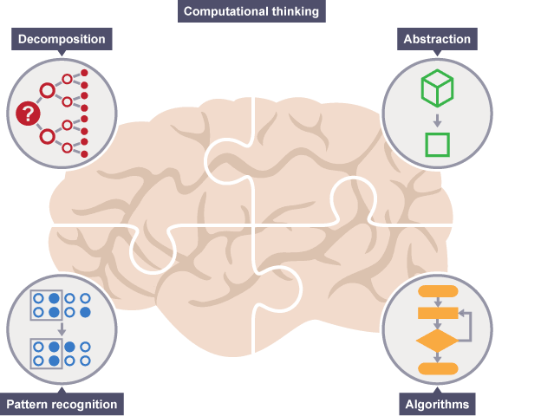
Four key concepts of CT
breaking down a complex problem or system into smaller, more manageable parts
focusing on the important information only, ignoring irrelevant detail
developing a step-by-step solution to the problem, or the rules to follow to solve the problem
looking for similarities among and within problems

Slide 5

Abstraction
A means of ignoring detail that is not of interest or unnecessary.
In programming, syntax would be a form of abstraction
Wing’s discussion of abstraction draws on a wide variety of concepts.
Ignoring, hiding information, levels and layers, models and implementation.
Two kinds of abstraction:
abstraction as modelling
abstraction as encapsulation.

Slide 6
Abstraction: Models
Abstraction as modelling can be understood in terms of the relationship between a part of reality and a model which represents the details of interest of this reality.
Reality
Validation
Qualification
Computer Simulation
Analysis & abstraction
Computer Model
Conceptual Model
Further abstraction & programming
Verification

Slide 7
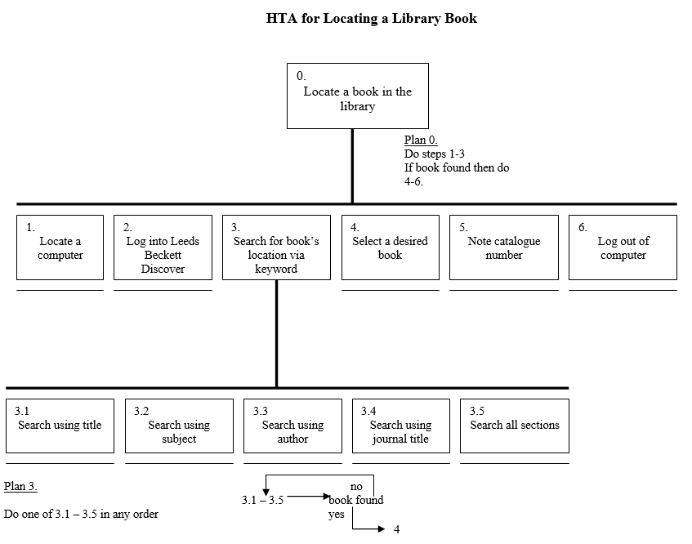
Models: Locating a book in the library

Slide 8
Models: Locating a book in the library
This model captures the essentials
Search options for the user in locating a desired book
Physical location of the book
Ignores certain details
Computer availability
What/where is Leeds Beckett Discover
In other words, the irrelevant details are not reflected by the structure of the data that the algorithm works with.

Slide 9
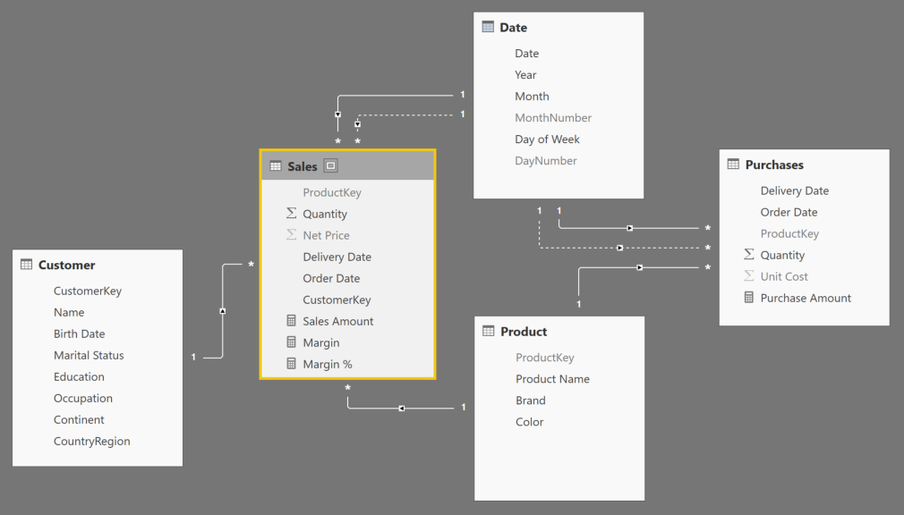
Abstraction: Models
An example – Data Model using PowerBI
Logical relationships between customer, sales, product, purchases and date tables

Slide 10
Abstraction: Encapsulation
A common concept in computing. Sometimes referred to as information hiding.
Encapsulate as to enclose (something) or put in a capsule.
In computer science, we define encapsulation as providing an interface for (a piece of software or hardware) to allow or simplify access for the user.

Slide 11
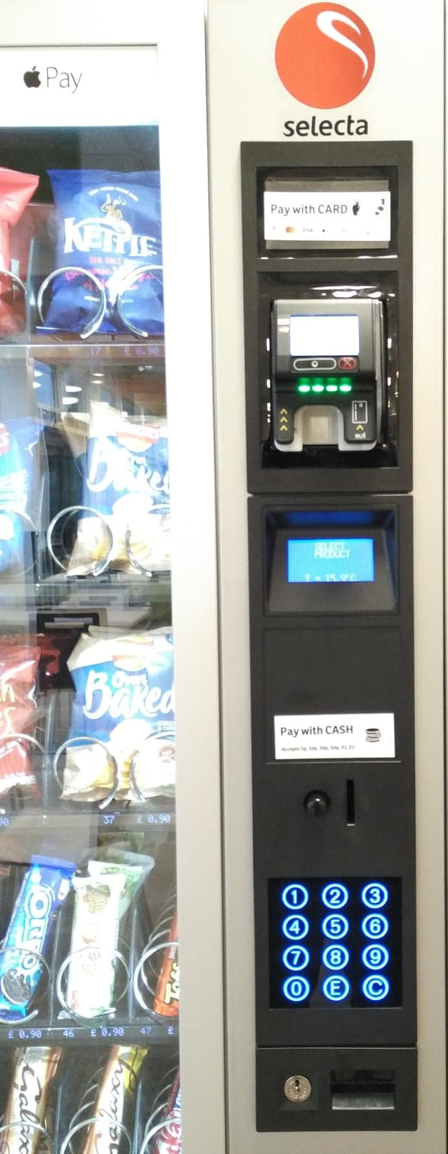
Abstraction: Encapsulation
The vending machine as an example.
The following functionality is encapsulated:
Prompt for (more) cash.
Correct product is dispensed.
Correct change is dispensed.

Slide 12
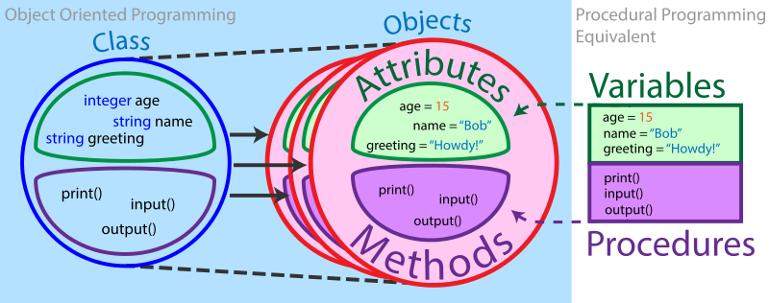
Abstraction: Encapsulation
Encapsulation in OOP: Java
Class is a blueprint for creating objects, where objects inherit properties of classes
Objects encapsulate complexity
https://brilliant.org/wiki/object-oriented-programming/

Slide 13
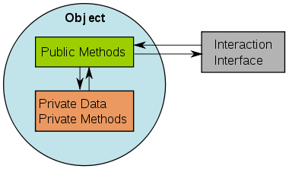
Abstraction: Encapsulation
/*some methods have been omitted in this code snippet*/
public class VendingMachine { private double CrispsCost; private double ChocolateCost; private double changeFromLastPurchase = 0; public VendingMachine (double CrispsCost, double ChocolateCost) { this.CrispsCost = CrispsCost; this.ChocolateCost = ChocolateCost; } public double getCrispsCost(){ return CrispsCost; } public double getChocolateCost(){ return ChocolateCost; } public void buyItem(String whichItem, double payment){ resetLastPurchaseChange(); if(itemExists(whichItem)) { if(paymentIsEnough(whichItem, payment)) { dispenseItem(whichItem); calculateChange(whichItem, payment); } else { alertUser(whichItem, payment); } } } public double getChange() { return changeFromLastPurchase; } private boolean paymentIsEnough(String whichItem, double payment) { if(whichItem.equals("Crisps")) { return payment >= CrispsCost; } else if (whichItem.equals("Chocolate")) { return payment >= ChocolateCost; } else { return false; } } private void dispenseItem(String whichItem) { System.out.println("Here's your " + whichItem); }
... }
The vending machine application in Java
https://brilliant.org/wiki/object-oriented-programming/

Slide 14
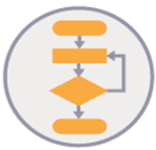
Algorithms
What makes an algorithm?
It is a set of instructions of how to do something and the order they must be done.
Are solutions to problems.
Has 3 properties:
An algorithm consists of a step-by-step list of instructions.
An algorithm is a finite process – guaranteed to finish at some point!
An algorithm should solve any instance of the problem that might arise.

Slide 15
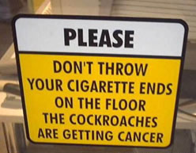
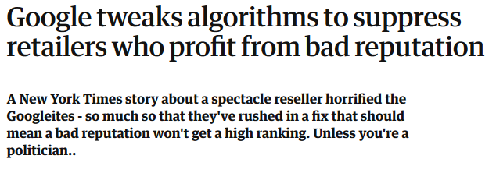
Algorithms
Not all lists of rules are algorithms!
Think of notices
Think of Google fastest route
Algorithms are about how, not what.
https://www.theguardian.com/technology/blog/2010/dec/02/google-algorithm-bad-retailers-downgrade

Slide 16
Algorithms
Some real-world applications:
Dealing with lost packets when using Wi-Fi
Getting your credit-card details securely to an online store
Google search and ranking of webpages

Slide 17
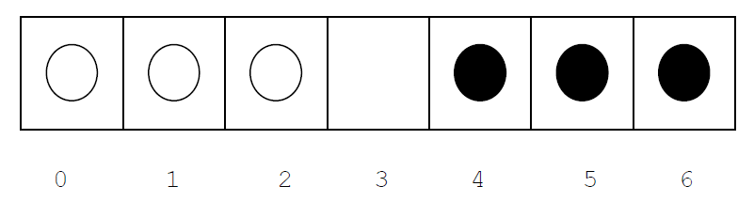
Algorithms
Consider this puzzle where you need to move all black pieces to positions 0, 1 and 2 and all white pieces to positions 4, 5 and 6.
You are allowed to move a piece one empty position forward OR jump the piece two empty positions forward.
A 15-step algorithm for solving the puzzle is as follows:
1. Move the piece in square 2 to square 3.
2. Jump the piece in square 4 to square 2.
3. Move the piece in square 5 to square 4.
4. Jump the piece in square 3 to square 5.
5. Jump the piece in square 1 to square 3.
6. Move the piece in square 0 to square 1.
7. Jump the piece in square 2 to square 0.
8. Jump the piece in square 4 to square 2.
9. Jump the piece in square 6 to square 4.
10. Move the piece in square 5 to square 6.
11. Jump the piece in square 3 to square 5.
12. Jump the piece in square 1 to square 3.
13. Move the piece in square 2 to square 1.
14. Jump the piece in square 4 to square 2.
15. Move the piece in square 3 to square 4.

Slide 18
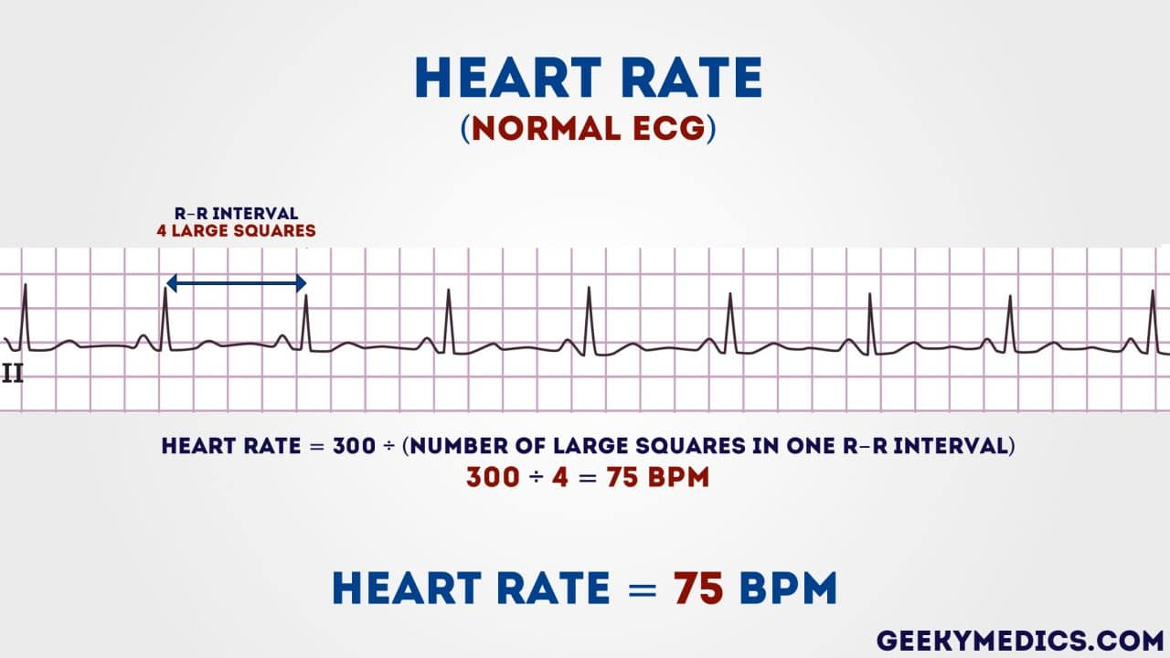
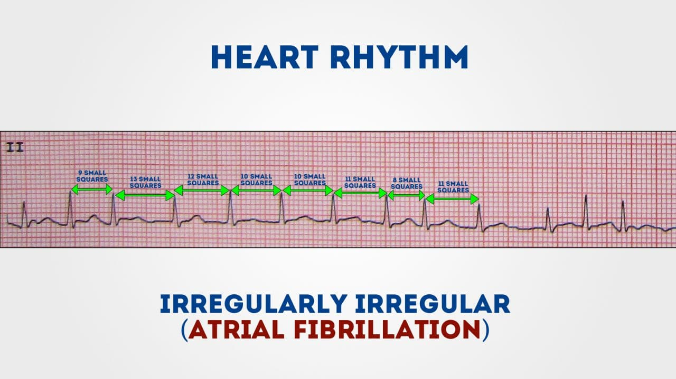
Algorithms
How to read an ECG
https://geekymedics.com/how-to-read-an-ecg/#2

Slide 19
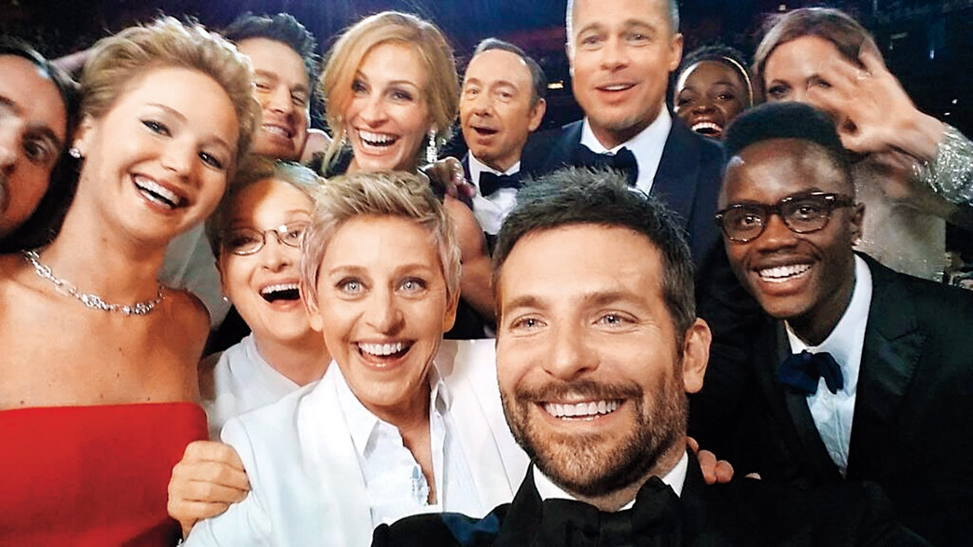
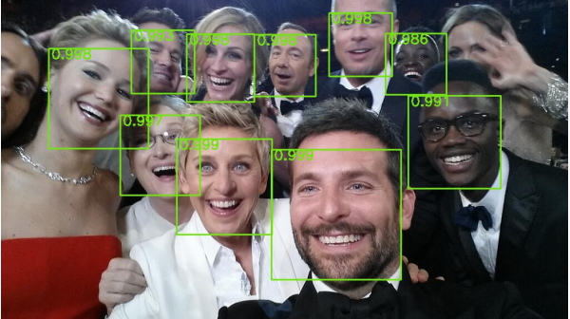
Algorithms
https://www.technologyreview.com/s/535201/the-face-detection-algorithm-set-to-revolutionize-image-search/

Slide 20
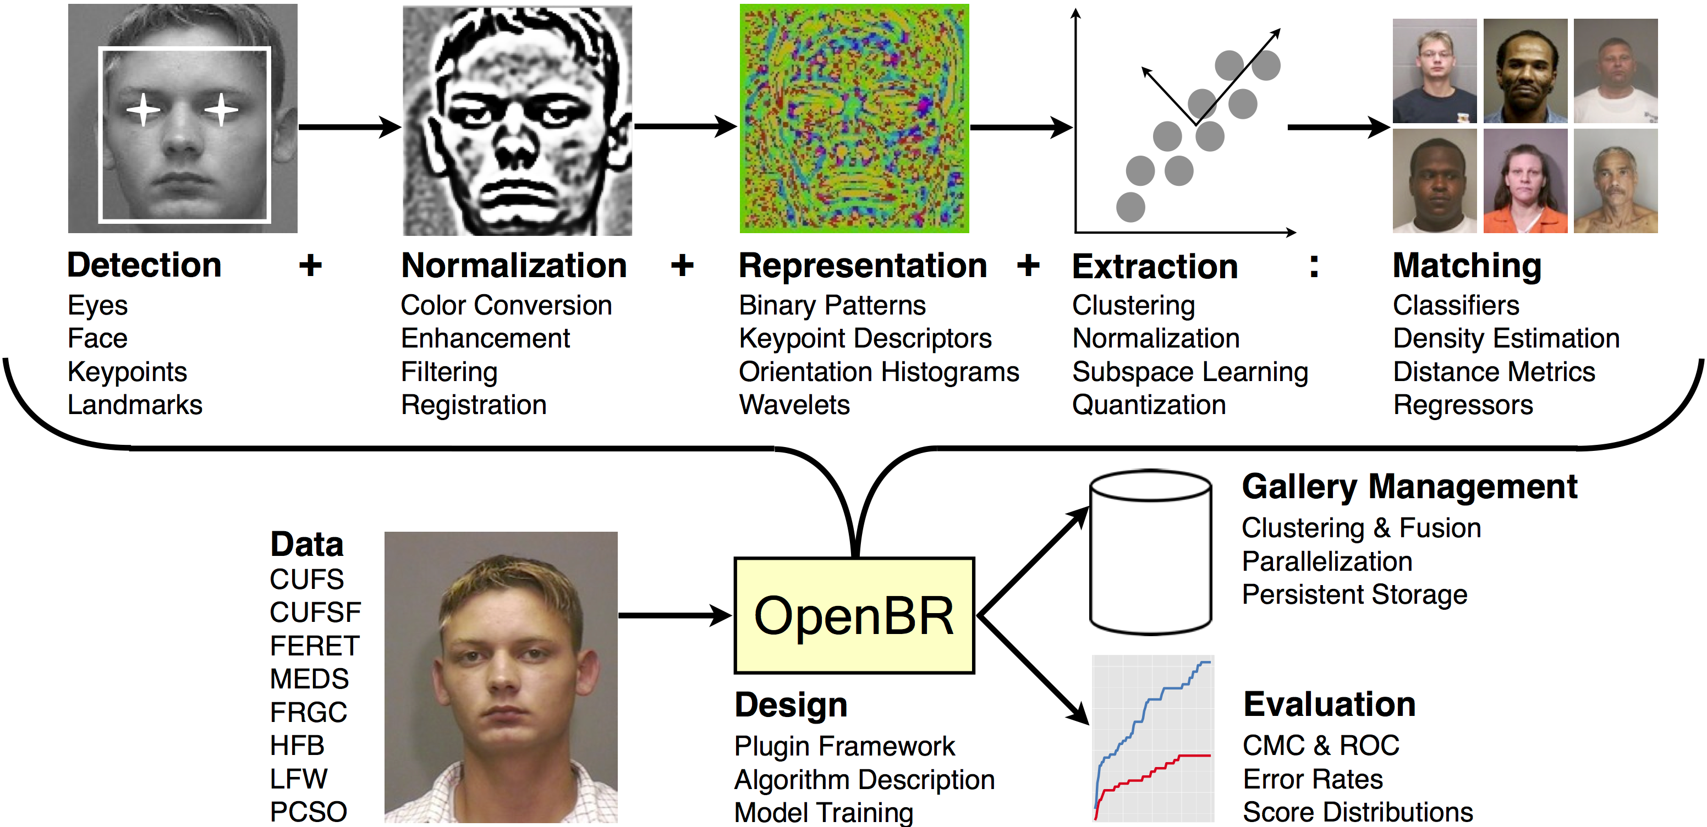
Algorithms
http://openbiometrics.org/

Slide 21
5 Important Algorithms in Tech
PageRank - how Google calculates search results
Public key cryptography - keeping credit card data secure
Correcting reading errors in CDs
Protecting passwords
Perlin noise: generating landscapes in games
https://www.businessinsider.com/the-5-most-important-algorithms-in-tech-2013-10?IR=T

Slide 22
More key concepts next week!
At the meantime, you have logic puzzles to solve for 2 weeks.
Puzzles similar to these will form your Phase Test questions - week beginning 2nd December.

